Slide 1



Time Series Forecasting-
Fuel Prices
Edmalyn Pacanor | Tristan Munar

Slide 2

Data is the new oil
02/20

Slide 3

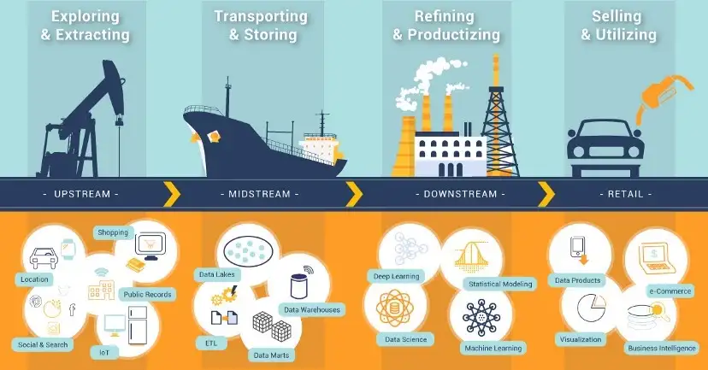
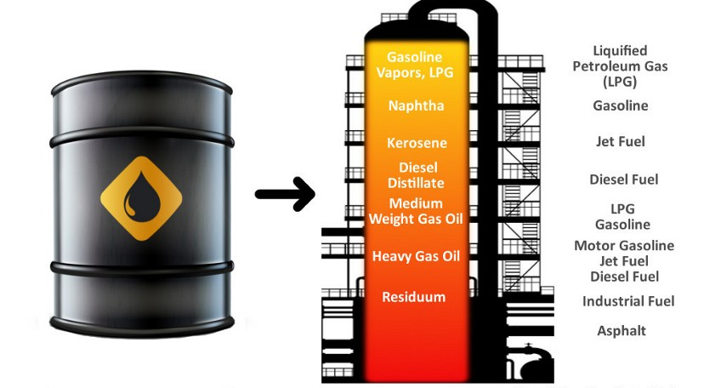



Oil Value Chain
Products that come from oil refining process
GASOLINE
JET FUEL
DIESEL
03/20

Slide 4
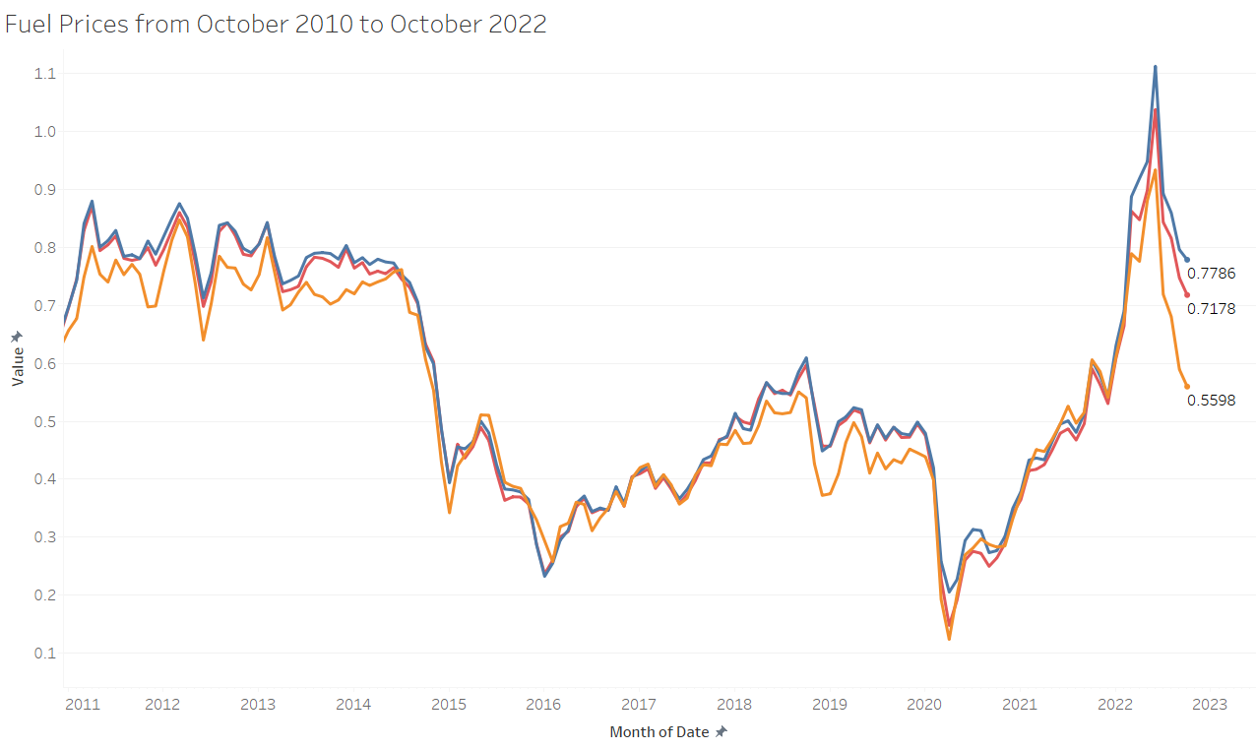


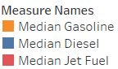
Dataset
Historical Daily Data of Fuel Prices from October 2010 to October 2022
USD/L
Mean of Platts Singapore(MOPS)
The mean of the high and low components of a Platts assessment for oil cargoes loading from Singapore. Often used as a component in floating price deals.
Gasoline
Diesel
Jet Fuel
Year
04/20

Slide 5



Problem
What is the best time series forecasting model for fuel prices?
The problem being addressed in this project is the need for accurate forecasting of fuel prices. Fuel prices have a significant impact on various industries and can affect the overall economy.
05/20

Slide 6




Stakeholders
Government
Oil Companies
General Public
06/20

Slide 7

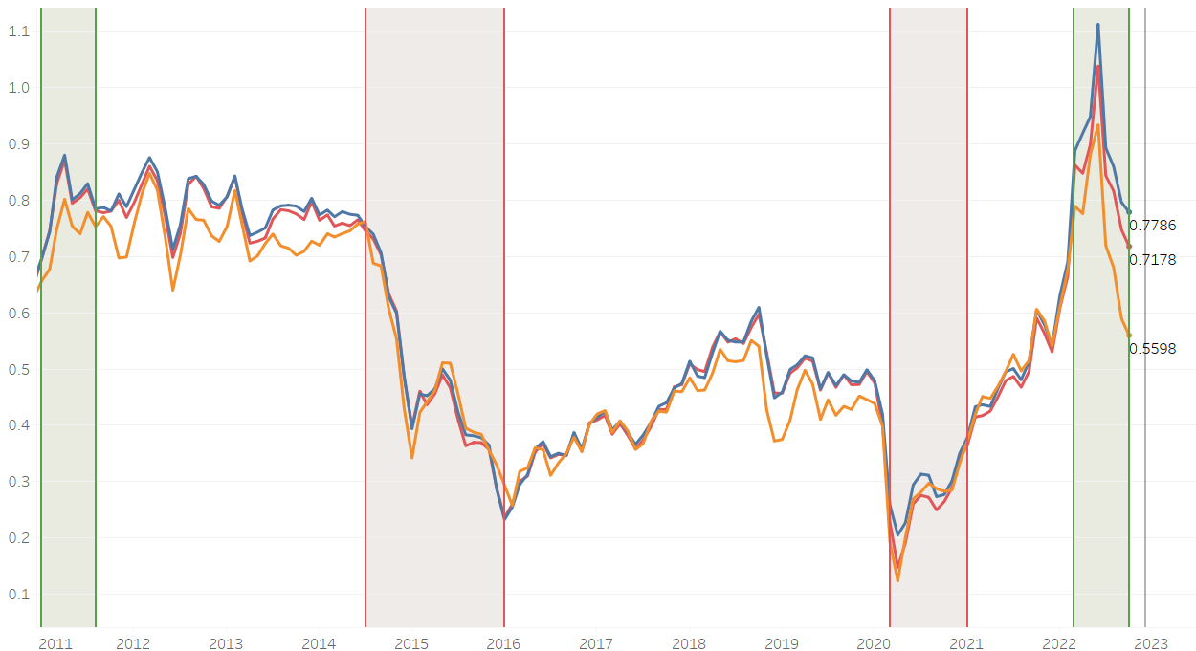

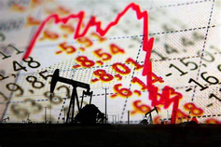

Exploratory Data Analysis
Shocks on Fuel prices are brought by global events.
Ukraine- Russia Conflict
February 2022
Libya Revolt of 2011
DIESEL
JET FUEL
USD/L
GASOLINE
Great Oil Crash of 2014
Covid-19 Pandemic
March 2020
Year
07/20

Slide 8
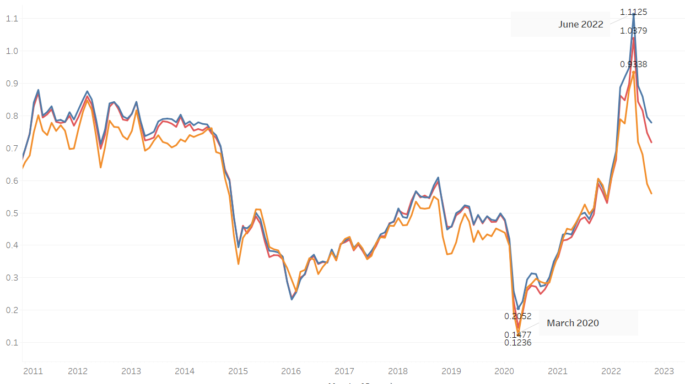
Exploratory Data Analysis
Fuel prices plunged into their lowest points on March 2020 and spiked into their highest points on June 2022.
USD/L
Gasoline
Diesel
Jet Fuel
Year
08/20

Slide 9
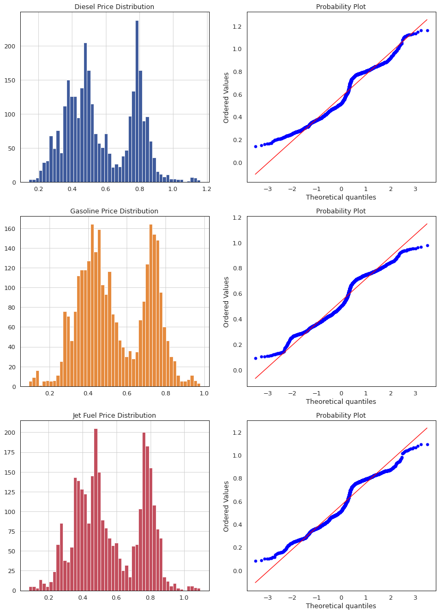
Exploratory Data Analysis
The time series data is non-stationary and does not have a normal distribution.
Gasoline
Diesel
Jet Fuel
09/20

Slide 10
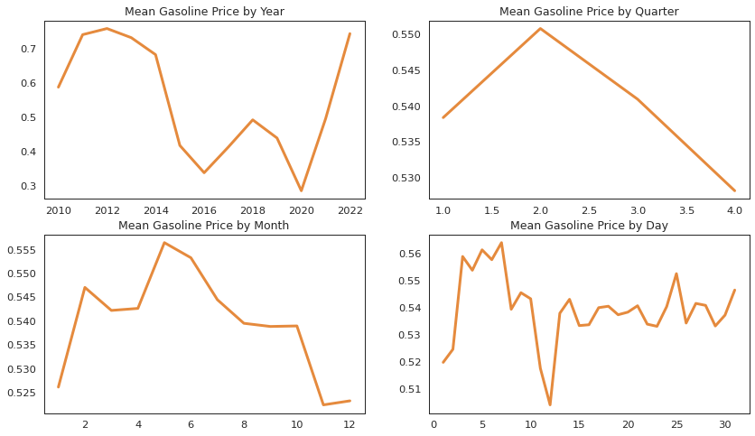
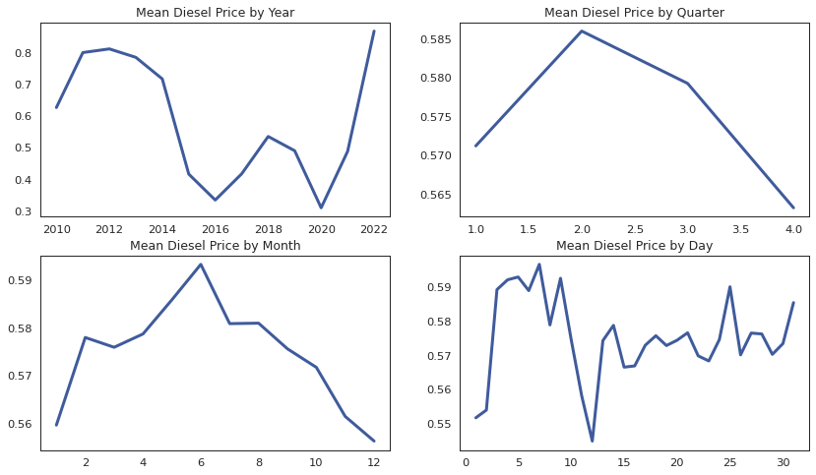
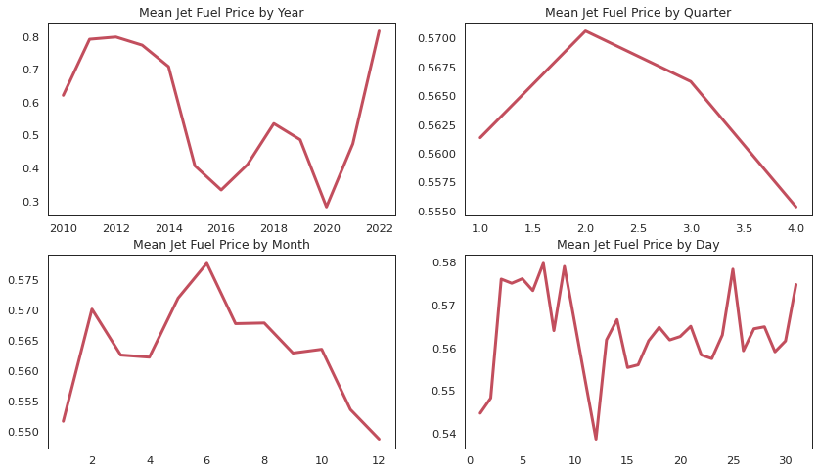
Exploratory Data Analysis
Diesel and Jet Fuel are highest during the month of June while Gasoline is highest during the month of May. Consequently, Diesel and Jet Fuel are lowest during December while Gasoline is lowest during November.
Mean Prices by Month
Gasoline
Diesel
Jet Fuel
10/20

Slide 11
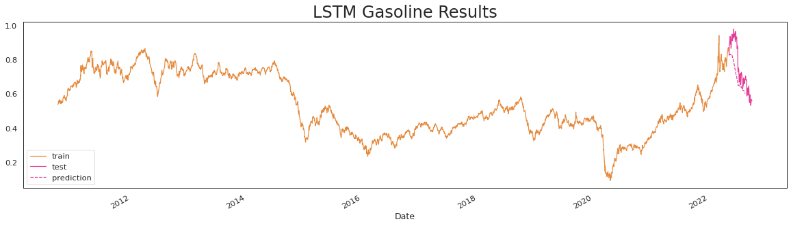
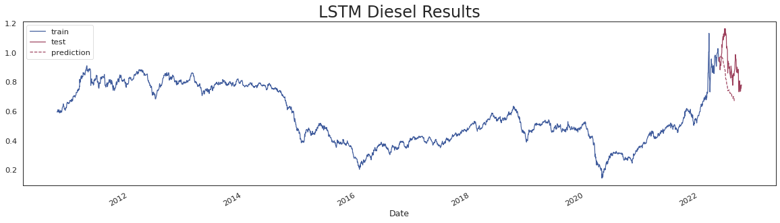
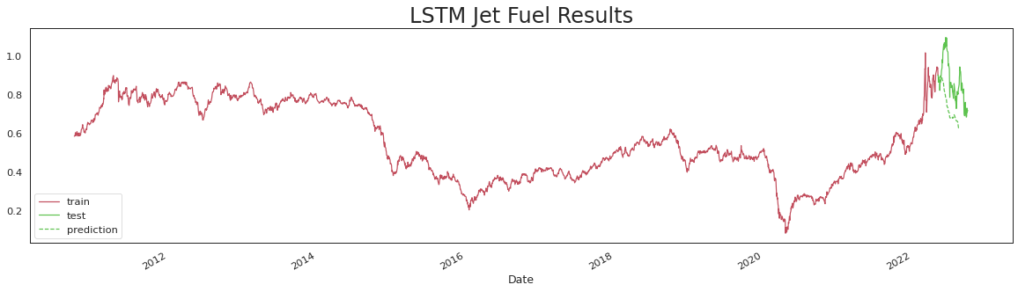
LSTM Results
PARAMETERS
train-test: 2900-100
window: 30
lstm: 200
epoch: 20
drop-out: 0.2
TRANSFORMATION
differencing
inverse differencing
Gasoline
Diesel
11/20
Jet Fuel

Slide 12
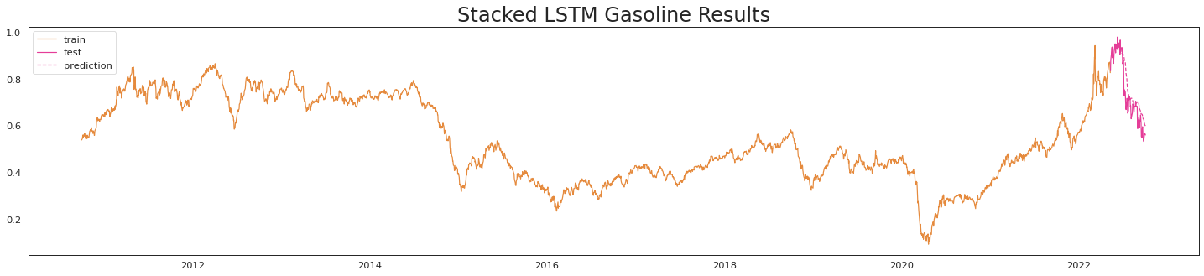
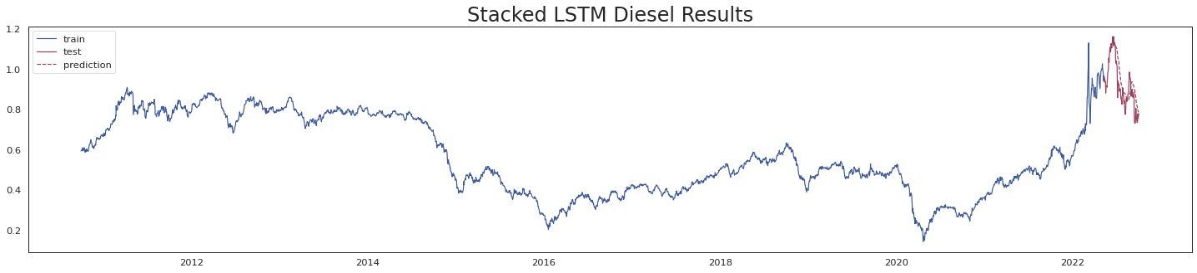
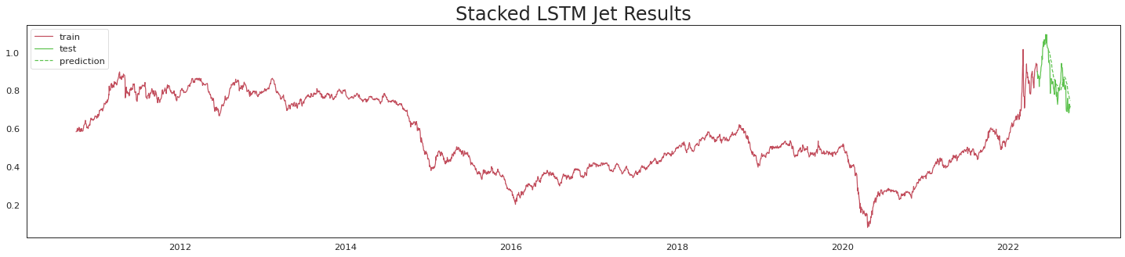
Stacked LSTM Results
PARAMETERS
train-test: 2900-100 size/lookback: 30
lstm: 3 stacks of 100
epoch: 20
TRANSFORMATION
no transformation done
Gasoline
Diesel
12/20
Jet Fuel

Slide 13
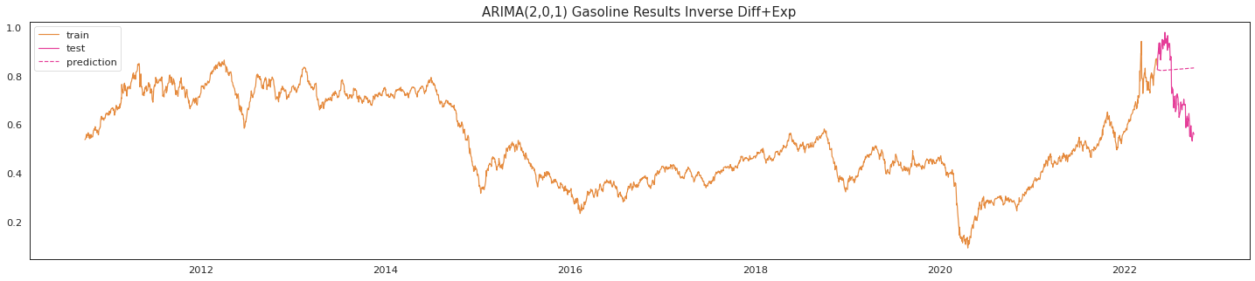
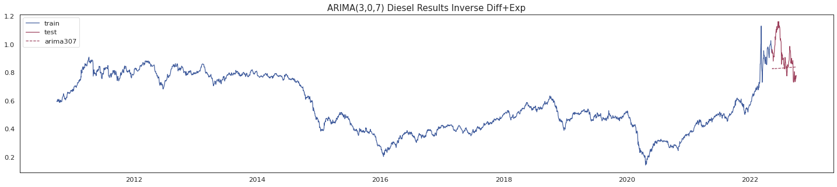
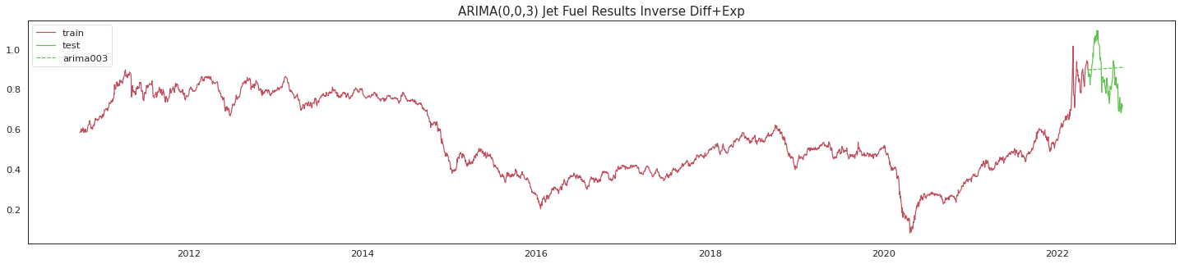
ARIMA Results
PARAMETERS
pdq: auto-arima
train-test: 2900-100
TRANSFORMATION
differencing
np.log
np.exp
inverse diff
Gasoline
Diesel
13/20
Jet Fuel

Slide 14
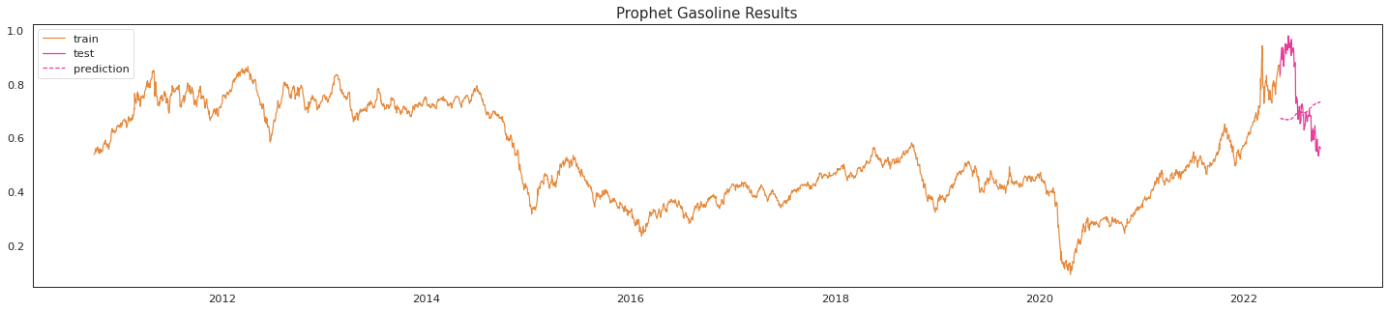
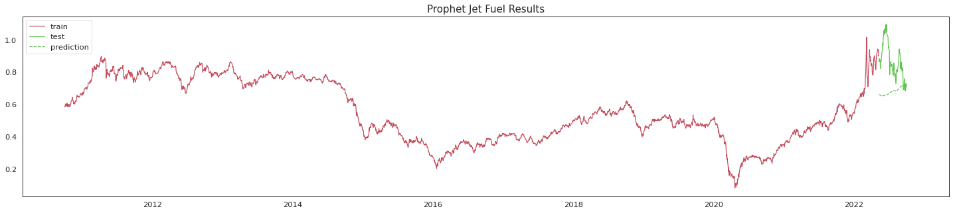
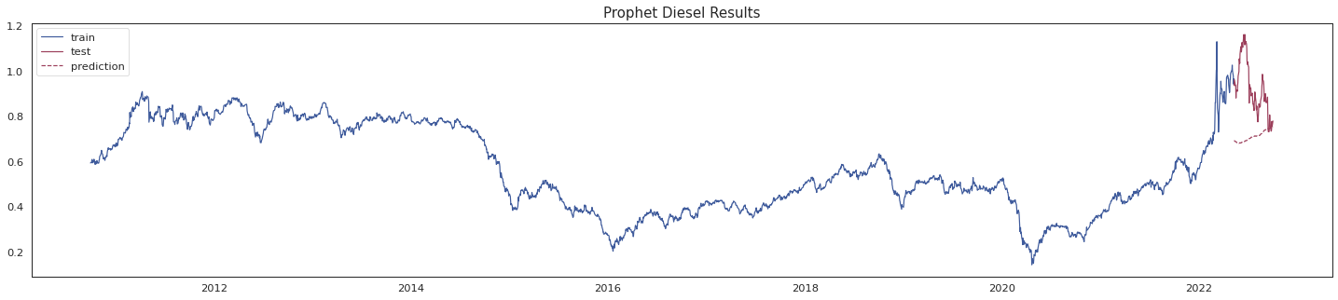
FB Prophet Results
PARAMETERS
train-test: 2900-100
No parameter tuning done
TRANSFORMATION
no transformation done
Gasoline
Diesel
14/20
Jet Fuel

Slide 15
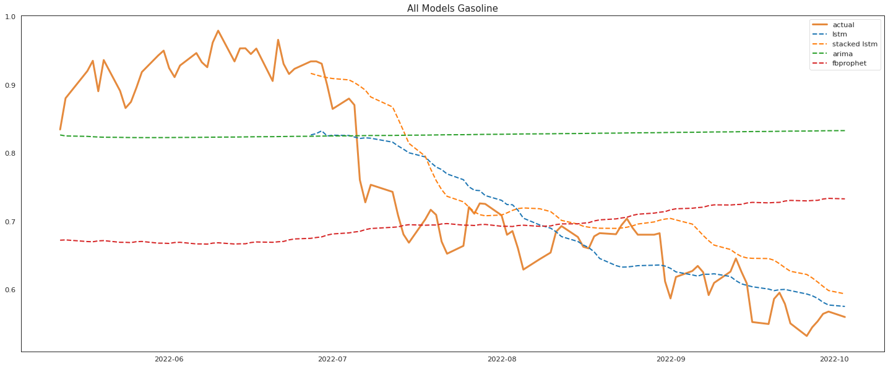
Comparison of Models on Gasoline
MODEL | MSE | RMSE | R2
LSTM | 0.13394190480930987 | 0.36598074376845274 | -0.5729687972964623
STACKED LSTM | 0.04921094859231963 | 0.0625785750919245 | 0.5713040677217514
ARIMA | 0.8310929407507208 | 0.911642989744736 | -537.3534703455863
FB PROPHET | 0.13757697136767116 | 0.37091369800490137 | -0.498081229570422
15/20

Slide 16
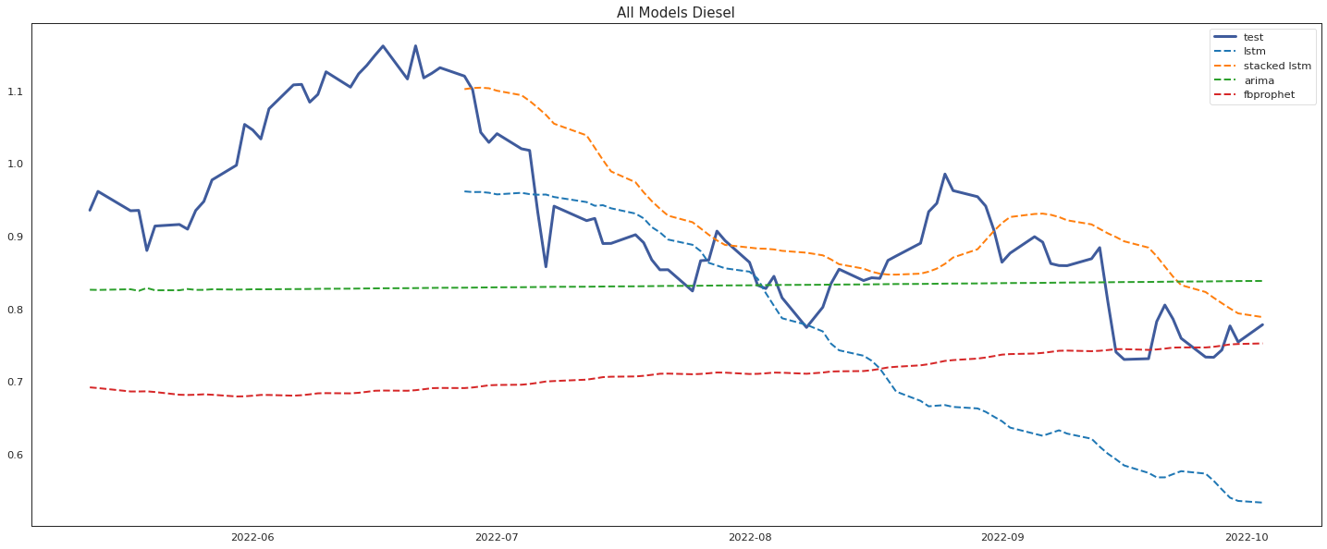
Comparison of Models on Diesel
MODEL | MSE | RMSE | R2
LSTM | 0.13837625618716826 | 0.3719895915038057 | -0.9482928960490968
STACKED LSTM | 0.05978442095029226 | 0.07141706228655956 | 0.37960841894820607
ARIMA | 0.8341935527031358 | 0.8341935527031358 | -634.7242488080614
FB PROPHET | 0.21577873248121254 | 0.4645198946021715 | -3.6908934160514493
16/20

Slide 17
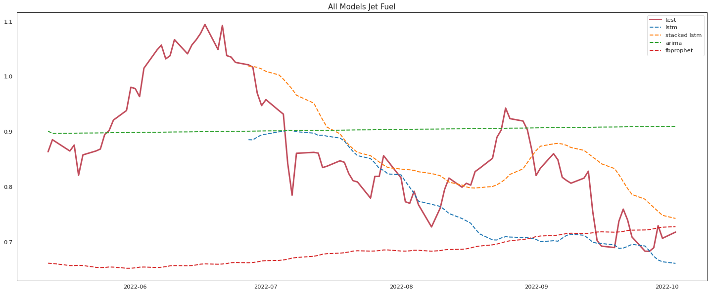
Comparison of Different Models on Jet Fuel
MODEL | MSE | RMSE | R2
LSTM | 0.15849829175112304 | 0.39811843935080804 | -1.9958464437086425
STACKED LSTM | 0.04904038268259749 | 0.05994168924894119 | 0.45567679342918455
ARIMA | 0.9056194039383874 | 0.951640375319578 | -703.8153095248739
FB PROPHET | 0.19120676083090044 | 0.43727195294336046 | -3.3389751913542174
17/20

Slide 18
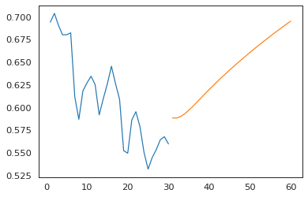
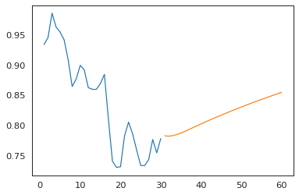
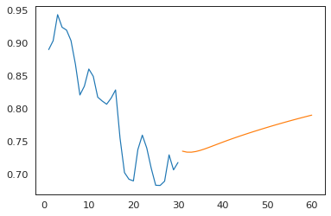
Stacked LSTM 30 Day Forecast
Gasoline
Diesel
Jet Fuel
19/20

Slide 19

Recommendations
Build a sustainable mass transport system
Leverage on the forecast in optimizing fuel reserves
Make use of alternatives; e-vehicles, bikes, walking
Encourage Work from Home/ Distance Learning setup
Carpool to and from work
20/20

